Slide 1
Declaration of
Independence

Slide 2
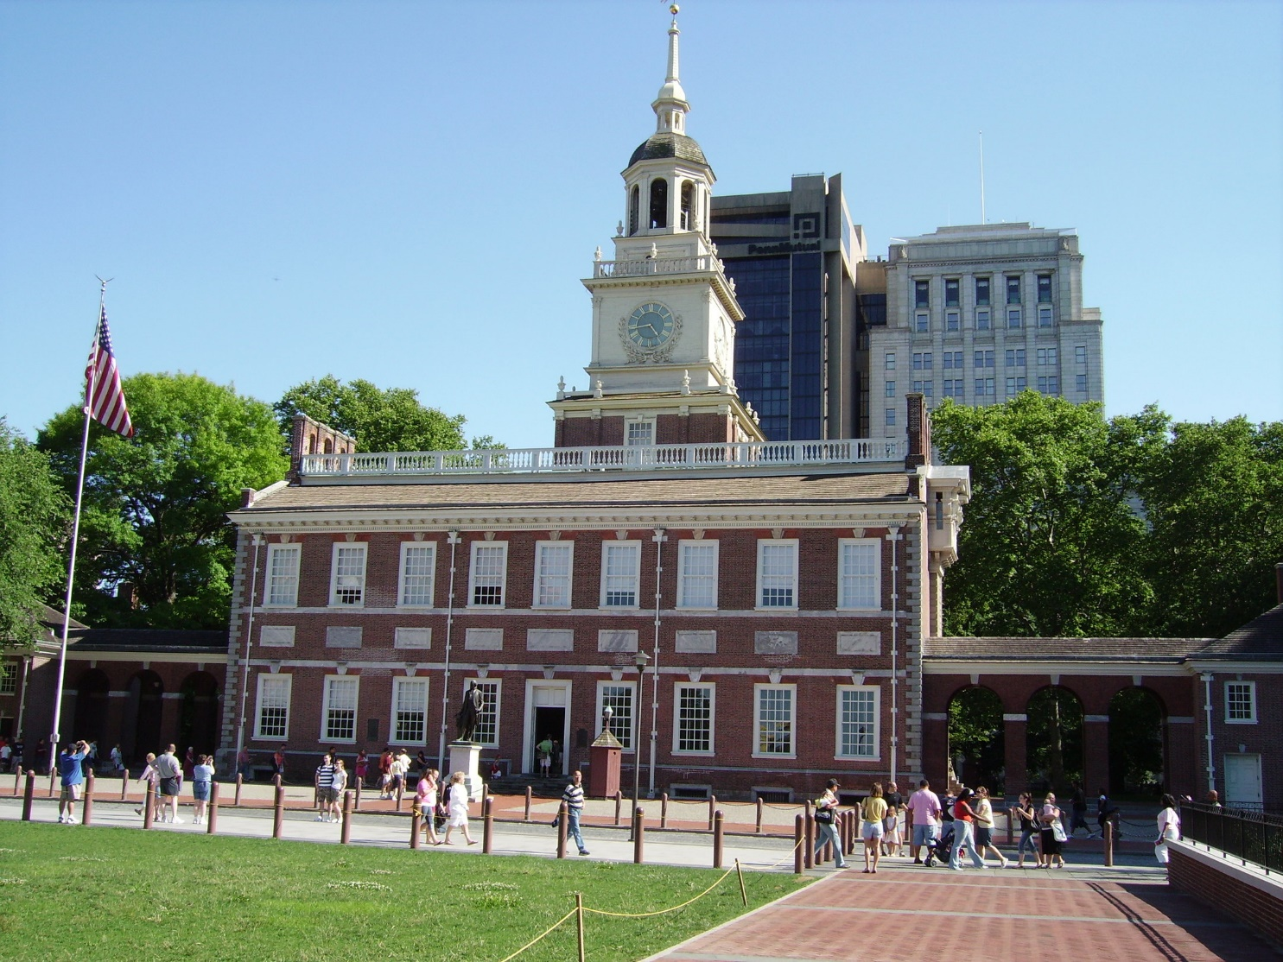
Location of the Second Continental Congress
Philadelphia

Slide 3
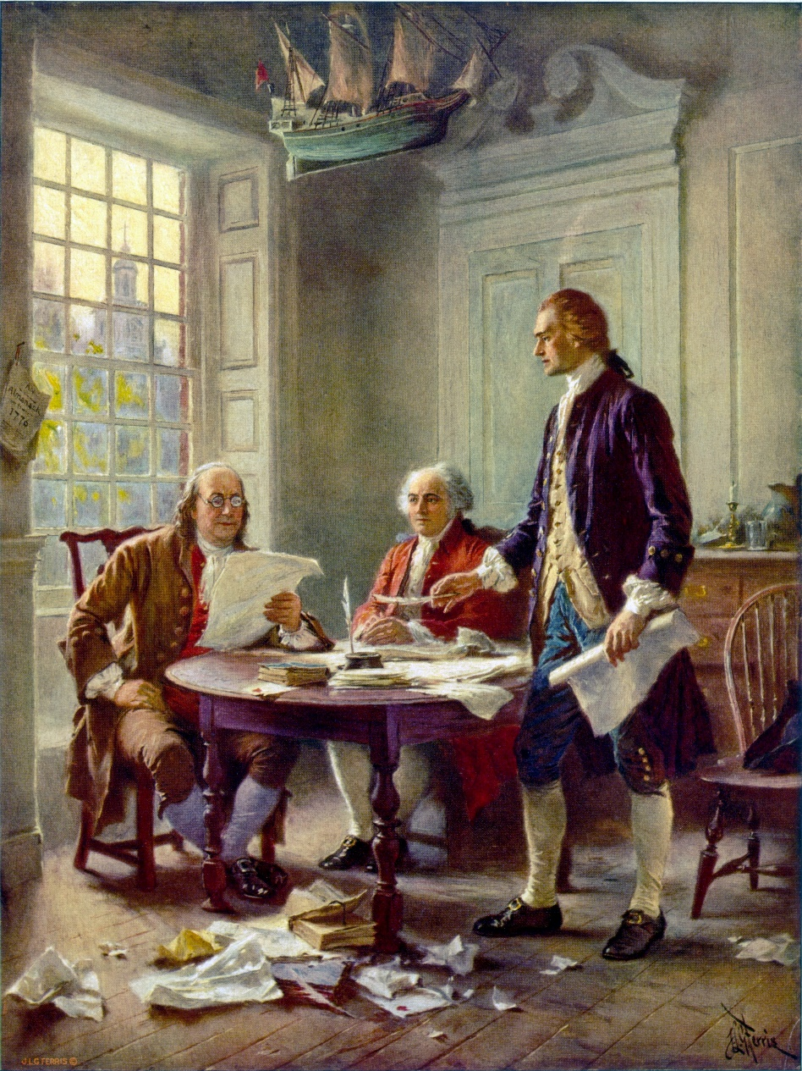
Who was in attendance?
John Adams
Ben Franklin
Thomas Jefferson was the main author.

Slide 4

Independence Day!
Presented to the delegates on July 2, 1776
Adopted by the Congress on July 4, 1776
John Hancock had the largest signature

Slide 5
Put the chart on the next slide in your notebook.
You will need a full page. Turn your notebook to the side (landscape) to draw the chart.

Slide 6
Natural Rights
Preamble
Grievances
Resolutions

